Slide 1



Department of Mathematics & Statistics
SEJONG UNIVERSITY, South Korea
Fuzzy Moderated Moderated-Mediation Analysis
and Its Neural Network-based Application
Beom Seok Kim, Kyung Jin Shin, Jin Hee Yoon
21/08/2023

Slide 2

Contents
Ⅰ
Motivation
Ⅱ
Preliminaries
Ⅲ
Main Contributions
Ⅳ
Data Analysis based on FLSE
Ⅴ
Neural Network-based Application
Ⅵ
Conclusion

Slide 3

Ⅰ
Motivation

Slide 4
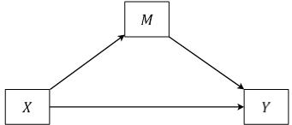
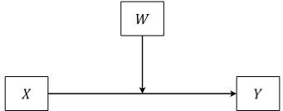
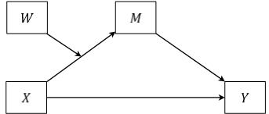
Ⅰ
Motivation
Mediation model, moderation model, moderated-mediation model have been used to explain the causality.
These models were insufficient to explain various forms of causality.
Mediation model
1. More complicated models
Moderation model
Moderated-Mediation model
4/26

Slide 5
Ⅰ
Motivation
Mediation model, moderation model, moderated-mediation model have been used to explain the causality.
These models were insufficient to explain various forms of causality.
Ambiguous things should be expressed by fuzzy numbers to present the fuzziness.
Fuzzy mediation and moderation analyses have been conducted recently.
1. More complicated models
2. Fuzzy analysis
Fuzzy Moderated Moderated-Mediation Analysis
Neural Network-based Application
Explain the causality with achieving enhanced performance of model.
5/26

Slide 6
Ⅱ
Preliminaries

Slide 7
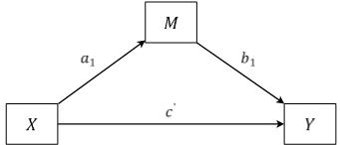
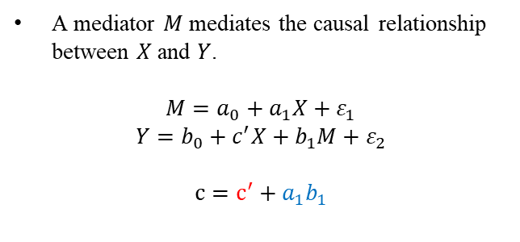

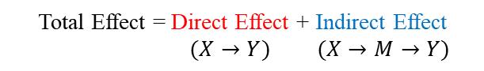
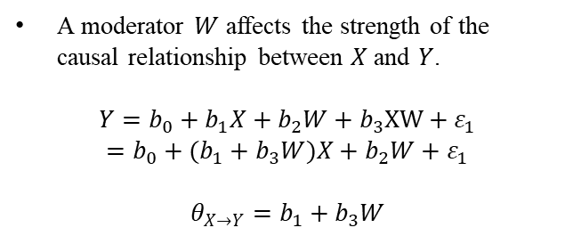
Ⅱ
Preliminaries
Simple Mediation & Moderation Analysis (Baron & Kenny, 1986)
Mediation model
A mediator $M$ mediates the causal relationship between $X$ and $Y$.
$$M=a_{0}+a_{1}X+ε_{1}$$
$$Y=b_{0}+c^{′}X+b_{1}M+ε_{2}$$
$$c=c^{′}+a_{1}b_{1}$$
Total Effect = Direct Effect + Indirect Effect
$(X→Y)$ $(X→M→Y)$
Moderation model
A moderator $W$ affects the strength of the causal relationship between $X$ and $Y$.
$$Y=b_{0}+b_{1}X+b_{2}W+b_{3}XW+ε_{1}$$
$$=b_{0}+(b_{1}+b_{3}W)X+b_{2}W+ε_{1}$$
$$θ_{X→Y}=b_{1}+b_{3}W$$
Conditional Effect = $θ_{X→Y}$
R.M. Baron, D.A. Kenny, The moderator–mediator variable distinction in social psychological research: Conceptual, strategic, and statistical considerations, Journal of Personality and Social Psychology. 51 (1986) 1173–1182.
7/26

Slide 8
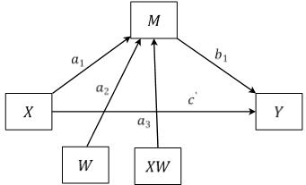
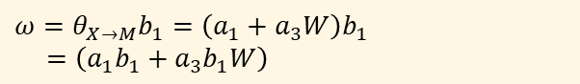
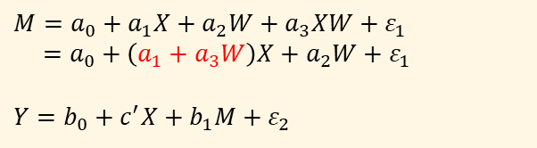
Ⅱ
Preliminaries
Moderated-Mediation Analysis (Langfred, 2004)
Model
$$M=a_{0}+a_{1}X+a_{2}W+a_{3}XW+ε_{1}$$
$=a_{0}+\left(a_{1}+a_{3}W\right)X+a_{2}W+ε_{1}$
$$Y=b_{0}+c^{′}X+b_{1}M+ε_{2}$$
Conceptual Diagram
Conditional Indirect Effect
$${ω=θ}_{X→M}b_{1}=\left(a_{1}+a_{3}W\right)b_{1}$$
$=\left(a_{1}b_{1}+a_{3}b_{1}W\right)$
Total Effect = Direct Effect + Indirect Effect
Statistical Diagram
$$c=c^{′}+θ_{X→M}b_{1}$$
C. W. Langfred, Too much of a good thing? The negative effects of high trust and autonomy in self managing teams. Academy of Management Journal, 47 (2004) 385-399.
8/26

Slide 9
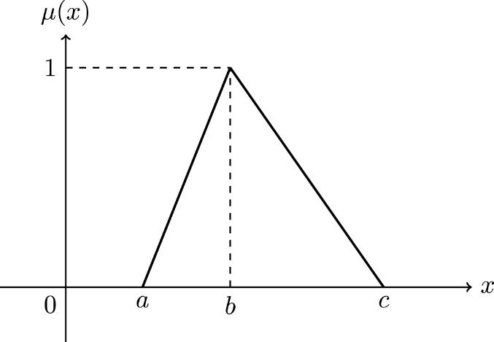
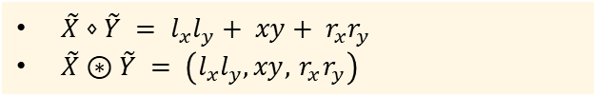
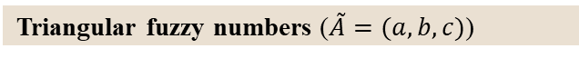
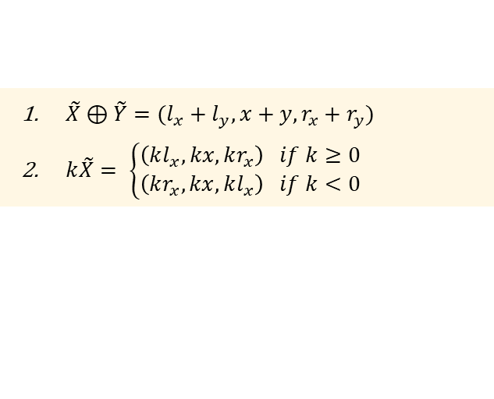
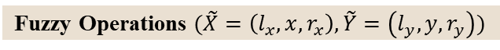
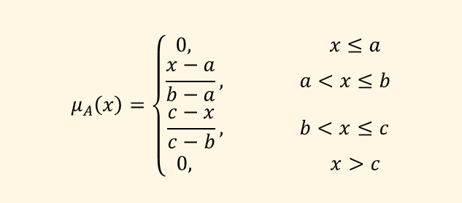
Ⅱ
Preliminaries
Fuzzy Numbers (Zadeh, 1965)
Triangular fuzzy numbers ($\tilde{A}=(a,b,c)$)
Triangular Fuzzy Numbers
$$μ_{A}\left(x\right)=\left\{\begin{aligned}0, x≤a \\ \frac{x−a}{b−a}, a<x≤b \\ \frac{c−x}{c−b}, b<x≤c \\ 0, x>c\end{aligned}\right.$$
Fuzzy Operations $(\tilde{X}=\left(l_{x},x,r_{x}\right),\tilde{Y}=\left(l_{y},y,r_{y}\right))$
$\tilde{X}⊕\tilde{Y}=(l_{x}+l_{y}, x+y, r_{x}+r_{y})$
$k\tilde{X}= \left\{\begin{aligned}\left(kl_{x},kx,kr_{x}\right) if k≥0 \\ \left(kr_{x},kx,kl_{x}\right) if k<0\end{aligned}\right.$
Fuzzy Operations (Yoon, 2013)
$\tilde{X}⋄\tilde{Y} = l_{x}l_{y}+ xy+ r_{x}r_{y}$
$\tilde{X}⊛\tilde{Y} = \left(l_{x}l_{y}, xy, { r}_{x}r_{y}\right)$
L.A. Zadeh, Fuzzy sets, Inf. Control 8 (1965) 338–353.
9/26

Slide 10
Ⅲ
Main Contributions

Slide 11
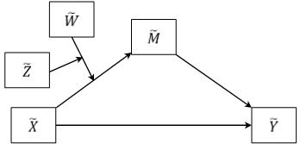
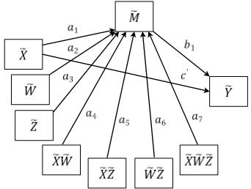
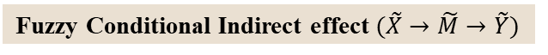
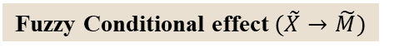
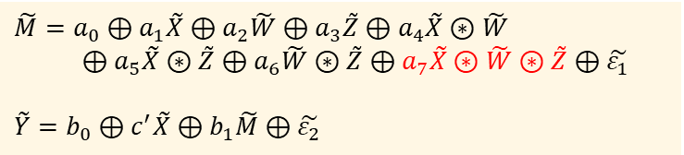
Ⅲ
Main Contributions
Fuzzy Moderated Moderated-Mediation Analysis
Model
$$\tilde{M}=a_{0}⊕a_{1}\tilde{X}⊕a_{2}\tilde{W}⊕a_{3}\tilde{Z}⊕a_{4}\tilde{X}⊛\tilde{W}$$
$⊕a_{5}\tilde{X}⊛\tilde{Z}⊕a_{6}\tilde{W}⊛\tilde{Z}⊕a_{7}\tilde{X}⊛\tilde{W}⊛\tilde{Z}⊕\tilde{ε_{1}}$
$$\tilde{Y}=b_{0}⊕c^{′}\tilde{X}⊕b_{1}\tilde{M}⊕\tilde{ε_{2}}$$
Conceptual Diagram
Fuzzy Conditional effect $(\tilde{X}→\tilde{M})$
$${θ_{\tilde{X}→\tilde{M}}=a}_{1}⊕a_{4}\tilde{W}⊕a_{5}\tilde{Z}{⊕a}_{7}\tilde{W}⊛\tilde{Z}$$
Fuzzy Conditional Indirect effect $(\tilde{X}→\tilde{M}→\tilde{Y})$
$$θ_{\tilde{X}→\tilde{M}} b_{1}\text{ = }a_{1}b_{1}⊕a_{5}b_{1}\tilde{Z}⊕\left(a_{4}b_{1}{⊕a}_{7}b_{1}\tilde{Z}\right)⊛\tilde{W}$$
Total Effect = Direct Effect + Indirect Effect
Statistical Diagram
$$c=c^{′}+θ_{\tilde{X}→\tilde{M}}b_{1}$$
11/26

Slide 12

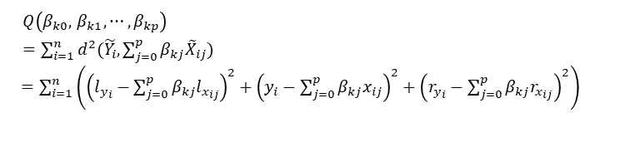
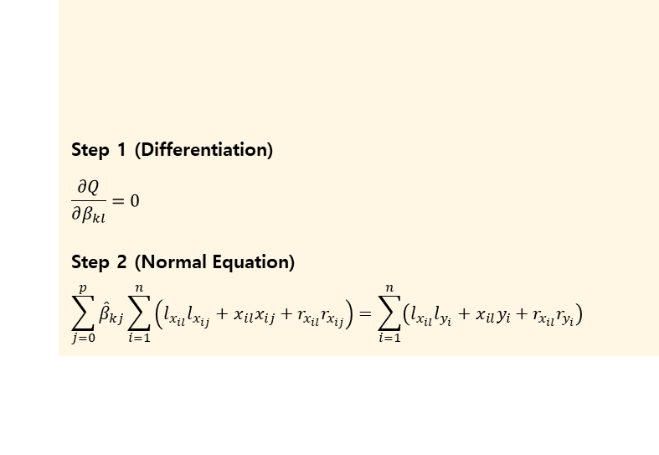
Ⅲ
Main Contributions
Fuzzy Least Squares Estimation (Yoon, 2013)
(FLSE)
$L_{2}$-metric based on distance approach
$$d^{2}\left(\tilde{X},\tilde{Y}\right)=D_{2}^{2}\left(Supp \tilde{X}, supp \tilde{Y} \right)+{\left[m_{l}\left(\tilde{X}\right)−m_{l}\left(\tilde{Y}\right)\right]}^{2}+{\left[m_{r}\left(\tilde{X}\right)−m_{r}\left(\tilde{Y}\right)\right]}^{2}$$
$${\tilde{Y}}_{i}=β_{0}⊕β_{1}{\tilde{X}}_{i1}⊕β_{2}{\tilde{X}}_{i2}⊕⋯⊕β_{p}{\tilde{X}}_{ip}⊕{\tilde{E}}_{i}$$
Step 1 (Differentiation)
$$\frac{∂Q}{∂β_{kl}}=0$$
Step 2 (Normal Equation)
$$\sum_{j=0}^{p}{{\hat{β}}_{kj}}\sum_{i=1}^{n}{\left(l_{x_{il}}l_{x_{ij}}+x_{il}x_{ij}+r_{x_{il}}r_{x_{ij}}\right)}=\sum_{i=1}^{n}{\left(l_{x_{il}}l_{y_{i}}+x_{il}y_{i}+r_{x_{il}}r_{y_{i}}\right)}$$
$$Q\left(β_{k0},{ β}_{k1}, ⋯, β_{kp}\right)$$
$=\sum_{i=1}^{n}{d^{2}(\tilde{Y_{i}},\sum_{j=0}^{p}{β_{kj}{\tilde{X}}_{ij})}}$
$=\sum_{i=1}^{n}{\left({\left(l_{y_{i}}−\sum_{j=0}^{p}{β_{kj}l_{x_{ij}}}\right)}^{2}+{\left(y_{i}−\sum_{j=0}^{p}{β_{kj}x_{ij}}\right)}^{2}+{\left(r_{y_{i}}−\sum_{j=0}^{p}{β_{kj}r_{x_{ij}}}\right)}^{2}\right)}$
OR
$$\hat{β_{k}}={\left({\tilde{X}}^{t}⋄\tilde{X}\right)}^{−1}{\tilde{X}}^{t}⋄\tilde{y}$$
J.H. Yoon, S.H. Choi, Fuzzy least squares estimation with new fuzzy operations, Adv. Intell. Syst. Comp. 190 (2013) 193–202.
12/26

Slide 13
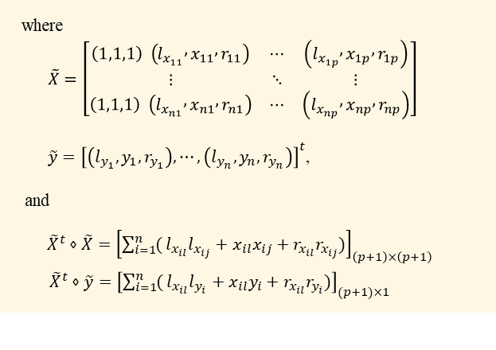
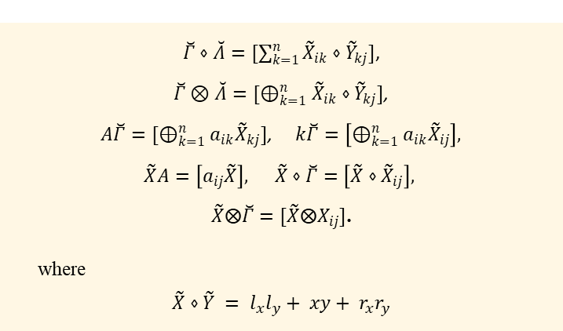
Ⅲ
Main Contributions
Fuzzy Least Squares Estimation (Yoon, 2013)
(FLSE)
Triangular fuzzy matrix operations
$\breve{Γ}=[{\tilde{X}}_{ij}]$, $\breve{Λ}=\left[{\tilde{Y}}_{ij}\right],$ $A=\left[a_{ij}\right]$
$$\hat{β_{k}}={\left({\tilde{X}}^{t}⋄\tilde{X}\right)}^{−1}{\tilde{X}}^{t}⋄\tilde{y}$$
$\breve{Γ}⋄\breve{Λ}=[\sum_{k=1}^{n}{{{\tilde{X}}_{ik}⋄\tilde{Y}}_{kj}}]$,
$\breve{Γ}⊗\breve{Λ}=[⊕_{k=1}^{n}{{\tilde{X}}_{ik}⋄\tilde{Y}}_{kj}]$,
$A\breve{Γ}=[⊕_{k=1}^{n}{a_{ik}\tilde{X}}_{kj}]$, $k\breve{Γ}=\left[⊕_{k=1}^{n}{a_{ik}\tilde{X}}_{ij}\right],$
$\tilde{X}A=\left[a_{ij}\tilde{X}\right],$ $\tilde{X}⋄\breve{Γ}=\left[\tilde{X}⋄{\tilde{X}}_{ij}\right],$
$\tilde{X}⨂\breve{Γ}=[\tilde{X}⨂X_{ij}]$.
where
$$\tilde{X}⋄\tilde{Y} = l_{x}l_{y}+ xy+ r_{x}r_{y}$$
where
$\tilde{X}=\left[\begin{matrix}\left(1,1,1\right) \left(l_{x_{11}} , x_{11} , r_{11}\right) & ⋯ & \left(l_{x_{1p}} , x_{1p} , r_{1p}\right) \\ ⋮ & ⋱ & ⋮ \\ \left(1,1,1\right) \left(l_{x_{n1}} , x_{n1} , r_{n1}\right) & ⋯ & \left(l_{x_{np}} , x_{np} , r_{np}\right)\end{matrix}\right]$
$\tilde{y}={\left[\left(l_{y_{1}},y_{1},r_{y_{1}}\right), ⋯, \left(l_{y_{n}}, y_{n}, r_{y_{n}}\right)\right]}^{t}$,
and
${\tilde{X}}^{t}⋄\tilde{X}={\left[\sum_{i=1}^{n}{(}l_{x_{il}}l_{x_{ij}}+x_{il}x_{ij}+r_{x_{il}}r_{x_{ij}})\right]}_{\left(p+1\right)×\left(p+1\right)}$
${\tilde{X}}^{t}⋄\tilde{y}={\left[\sum_{i=1}^{n}{(}l_{x_{il}}l_{y_{i}}+x_{il}y_{i}+r_{x_{il}}r_{y_{i}})\right]}_{(p+1)×1}$
J.H. Yoon, S.H. Choi, Fuzzy least squares estimation with new fuzzy operations, Adv. Intell. Syst. Comp. 190 (2013) 193–202.
13/26

Slide 14
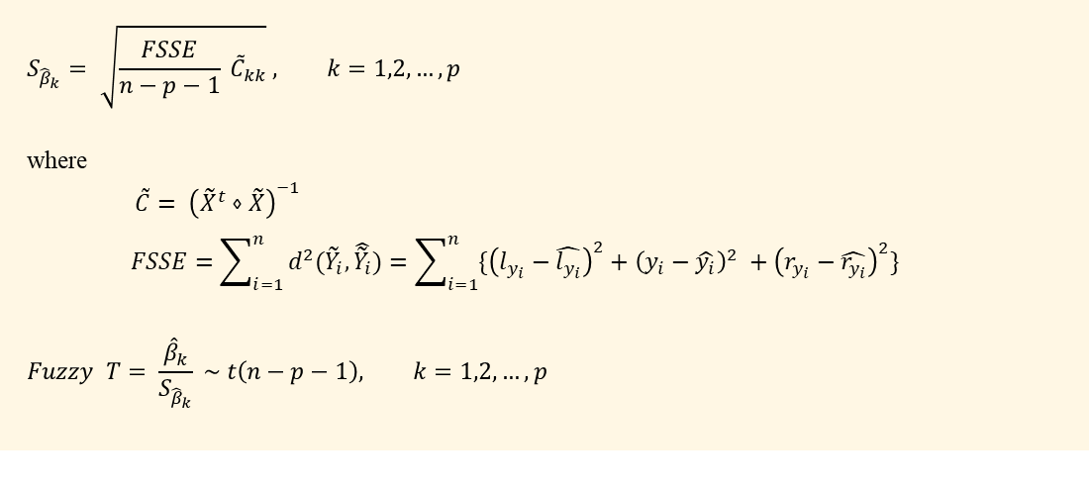
Ⅲ
Main Contributions
Fuzzy T-test
$H_{0}: β_{k}​=0$ $v.s. H_{1}: H_{0} is not true$ $(k=1, 2, …, p)$
$$S_{{\hat{β}}_{k}}= \sqrt{\frac{FSSE}{n−p−1} {\tilde{C}}_{kk}} , k=1,2, …, p$$
where
$\tilde{C}= {\left({\tilde{X}}^{t}⋄\tilde{X}\right)}^{−1}$
$$FSSE=\sum_{i=1}^{n}{d^{2}({\tilde{Y}}_{i}, \hat{{\tilde{Y}}_{i}})}=\sum_{i=1}^{n}{\{{\left(l_{y_{i}}−\hat{l_{y_{i}}}\right)}^{2}+{\left(y_{i}−\hat{y_{i}}\right)}^{2} +{\left(r_{y_{i}}−\hat{r_{y_{i}}}\right)}^{2}\}}$$
$$Fuzzy T= \frac{{\hat{β}}_{k}}{S_{{\hat{β}}_{k}}} \sim t\left(n−p−1\right), k=1,2, …, p$$
14/26

Slide 15
Ⅳ
Data Analysis
based on FLSE

Slide 16
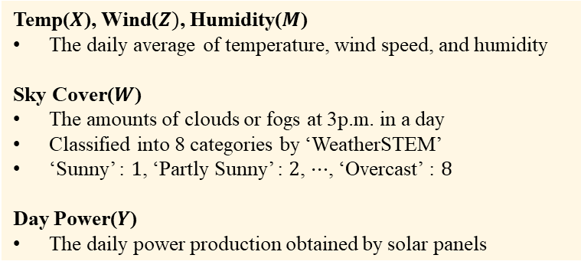
Ⅳ
Data Analysis based on FLSE
Solar Power Data
Dataset
1 : Weather status dataset in Belgium from 2016 to 2019 ¹
+
2 : Daily Power Production of Solar Panels dataset ²
Variables
Temp($X$), Wind($Z)$, Humidity($M$)
The daily average of temperature, wind speed, and humidity
Sky Cover($W$)
The amounts of clouds or fogs at 3p.m. in a day
Classified into 8 categories by ‘WeatherSTEM’
‘Sunny’ : $1$, ‘Partly Sunny’ : $2$, $⋯$, ‘Overcast’ : $8$
Day Power($Y$)
The daily power production obtained by solar panels
1 : https://www.kaggle.com/datasets/fvcoppen/solarpanelspower
2 : https://www.kaggle.com/datasets/ramima/weather-dataset-in-antwerp-belgium
16/26

Slide 17
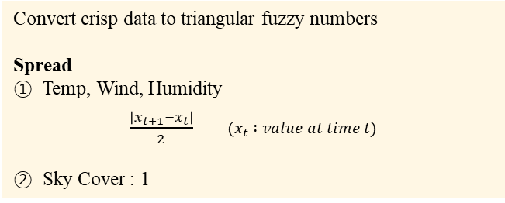
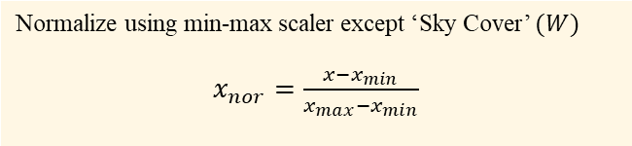
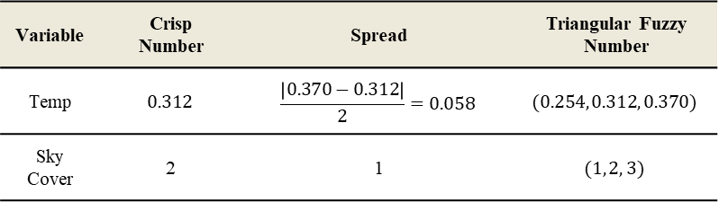
Ⅳ
Data Analysis based on FLSE
Data Preprocessing
1. Interpolation
Normalization
Missing values were replaced by cubic spline interpolation
Temp | Wind | Humidity | Sky cover | Day power
0.312052 | 0.234784 | 0.778769 | 2 | 0.058824
0.369939 | 0.412924 | 0.725910 | 3 | 0.058824
0.352761 | 0.572187 | 0.709644 | 5 | 0.058824
0.348520 | 0.334605 | 0.751113 | 3 | 0.029412
2. Normalization
Normalize using min-max scaler except ‘Sky Cover’ $(W)$
$x_{nor}=\frac{x−x_{min}}{x_{max}−x_{min}}$
3. Fuzzification
Fuzzification
Convert crisp data to triangular fuzzy numbers
Spread
Temp, Wind, Humidity
$\frac{\left|x_{t+1}−x_{t}\right|}{2}$ $(x_{t} :value at time t)$
Sky Cover : 1
Variable | Crisp Number | Spread | Triangular Fuzzy Number
Temp | $$0.312$$ | $$\frac{\left|0.370−0.312\right|}{2}=0.058$$ | $$(0.254, 0.312, 0.370)$$
Sky Cover | 2 | 1 | $$(1, 2, 3)$$
17/26

Slide 18
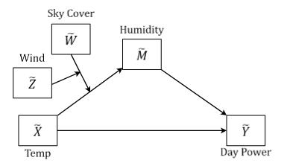
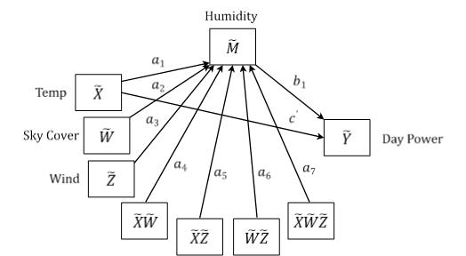
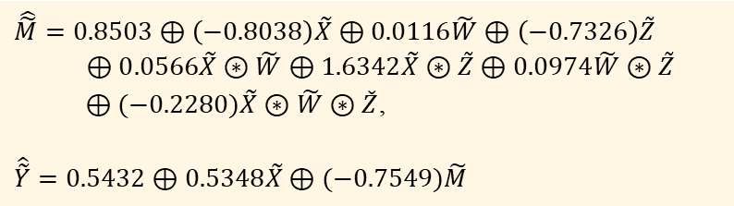
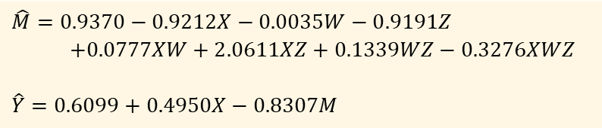
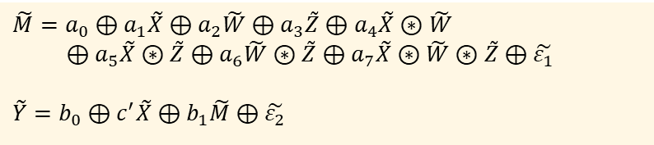
Ⅳ
Data Analysis based on FLSE
Application to Moderated Moderated-Mediation Model
Model
$$\tilde{M}=a_{0}⊕a_{1}\tilde{X}⊕a_{2}\tilde{W}⊕a_{3}\tilde{Z}⊕a_{4}\tilde{X}⊛\tilde{W}$$
$⊕a_{5}\tilde{X}⊛\tilde{Z}⊕a_{6}\tilde{W}⊛\tilde{Z}⊕a_{7}\tilde{X}⊛\tilde{W}⊛\tilde{Z}⊕\tilde{ε_{1}}$
$$\tilde{Y}=b_{0}⊕c^{′}\tilde{X}⊕b_{1}\tilde{M}⊕\tilde{ε_{2}}$$
Crisp
Conceptual Diagram
$$\hat{M}=0.9370−0.9212X−0.0035W−0.9191Z$$
$+0.0777XW+2.0611XZ+0.1339WZ−0.3276XWZ$
$$\hat{Y}=0.6099+0.4950X−0.8307M$$
Fuzzy
$$\hat{\tilde{M}}=0.8503⊕\left(−0.8038\right)\tilde{X}⊕0.0116\tilde{W}⊕\left(−0.7326\right)\tilde{Z}$$
$⊕0.0566\tilde{X}⊛\tilde{W}⊕1.6342\tilde{X}⊛\tilde{Z}⊕0.0974\tilde{W}⊛\tilde{Z}$
$⊕(−0.2280)\tilde{X}⊛\tilde{W}⊛\check{Z}$,
$$\hat{\tilde{Y}}=0.5432⊕0.5348\tilde{X}⊕(−0.7549)\tilde{M}$$
Statistical Diagram
18/26

Slide 19
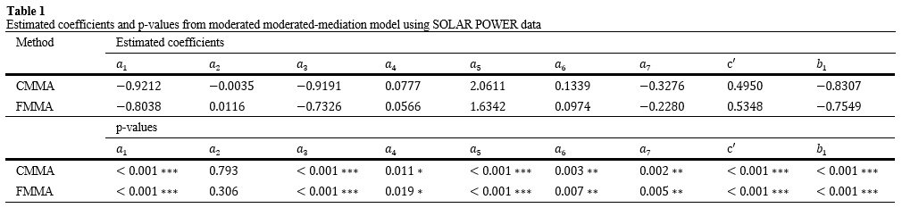
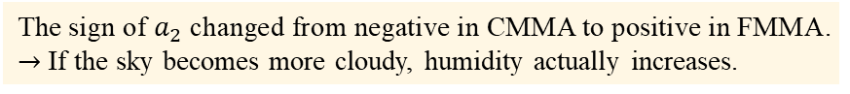
Ⅳ
Data Analysis based on FLSE
Results – $(1)$
Estimated Coefficients & p-values
CMMA - crisp multiple moderation analysis / FMMA - fuzzy multiple moderation analysis
Coefficient
The sign of $a_{2}$ changed from negative in CMMA to positive in FMMA.
$→$ If the sky becomes more cloudy, humidity actually increases.
P-value
The p-value of $a_{2}$ reduced significantly.
19/26

Slide 20
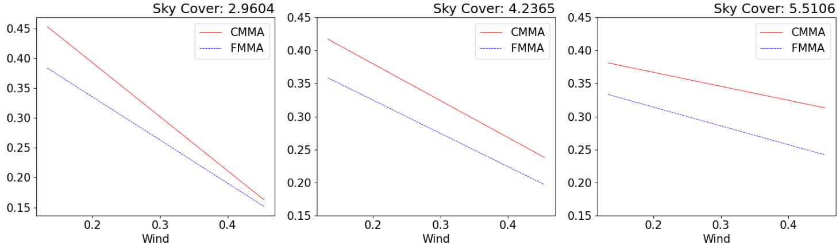
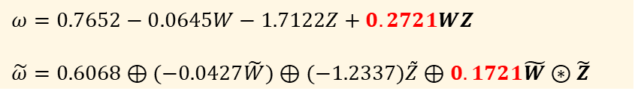


Ⅳ
Data Analysis based on FLSE
Results – $(2)$
Conditional Indirect Effect of $X$ on $Y$
$ω=0.7652−0.0645W−1.7122Z+0.2721WZ$
$$\tilde{ω}=0.6068⊕(−0.0427\tilde{W})⊕(−1.2337)\tilde{Z}⊕0.1721\tilde{W}⊛\tilde{Z}$$
Conditional Indirect Effect
$∴$ Using crisp numbers on ambiguous data can produce distorted results
due to the loss of information.
20/26

Slide 21
Ⅴ
Neural Network-based Application

Slide 22
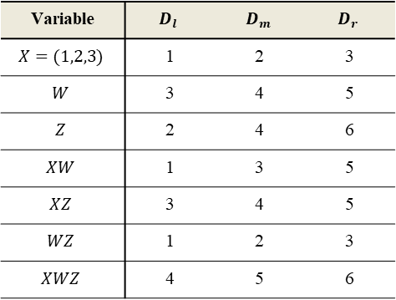


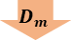
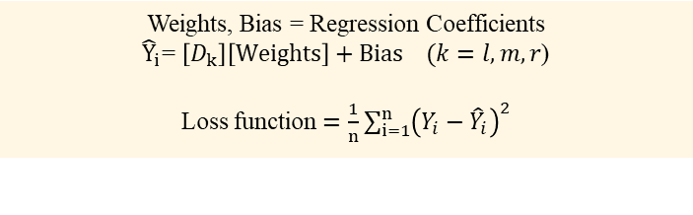
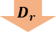
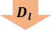
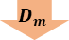
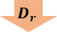
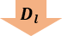
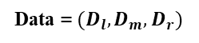
Ⅴ
Neural Network-based Application
Algorithm
Triangular Fuzzy Data
$$(D_{l}, D_{m}, D_{r})$$
Data = $(D_{l}, D_{m}, D_{r})$
Variable | $$D_{l}$$ | $$D_{m}$$ | $$D_{r}$$
$$X=(1,2,3)$$ | 1 | 2 | 3
$$W$$ | 3 | 4 | 5
$$Z$$ | 2 | 4 | 6
$$XW$$ | 1 | 3 | 5
$$XZ$$ | 3 | 4 | 5
$$WZ$$ | 1 | 2 | 3
$$XWZ$$ | 4 | 5 | 6
1
Separate $3$ elements of the Triangular Fuzzy Data
Simulation
$$D_{l}$$
$$D_{m}$$
$$D_{r}$$
Data
Solar power data
Optimization methods based on gradient descent
Stochastic gradient descent (SGD)
Momentum
Adagrad
Adam
2
Weights, Bias = Regression Coefficients
${\hat{Y}}_{i}$= $\left[D_{k}\right]\left[Weights\right]+Bias (k=l,m,r$)
Loss function $=\frac{1}{n}\sum_{i=1}^{n}{{\left(Y_{i}−{\hat{Y}}_{i}\right)}^{2}}$
Update
Weights & Bias
3
Obtain Regression Coefficients $[Bias, Weights]$
for $each D_{l}, D_{m}, D_{r}$
Dataset
1 2 3
$$D_{l}$$
$$D_{m}$$
$$D_{r}$$
4
Calculate the average of the coefficients of $(D_{l}, D_{m}, D_{r}$)
Average = Estimated Coefficients
22/26

Slide 23
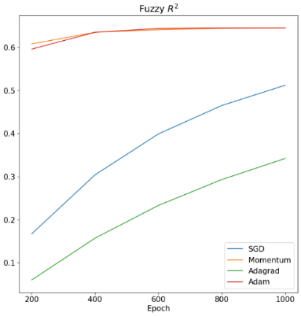
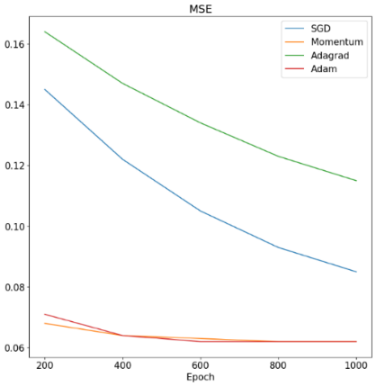




Ⅴ
Neural Network-based Application
Results
FLSE method
Use mathematical formulas
$→$ always yields same estimation
Neural Network
Use gradient descent
$→$ vary from various factors
(epochs, optimization method)
$∵$ Coefficients are updated in the direction of minimizing the cost function under the given conditions.
$$↓$$
$∴$ Develop to a fuzzy model integrated with deep neural networks that has higher performance.
< 1000 epochs >
Method | FLSE | SGD | Momentum | Adagrad | Adam
Fuzzy $R^{2}$ | $$0.645$$ | $$0.512$$ | $$0.645$$ | 0.342 | 0.645
FMSE | 0.062 | 0.085 | $$0.062$$ | 0.115 | 0.062
Fuzzy $R^{2}=1−\frac{FSSE}{FTSS}$ / FMSE$=\frac{FSSE}{n−p−1}$
23/26

Slide 24
Ⅵ
Conclusion

Slide 25
Ⅵ
Conclusion
Fuzzy Analysis
Neural Network
Expressing ambiguous data with fuzzy numbers reduced the loss of information and prevented distorted results.
The performance of the model was similar to our proposed fuzzy model.
Estimation depends on the various factors.
Future Discussion
Extension to the application of deep neural networks.
Develop models with stronger predictive performance and higher interpretability .
25/26

Slide 26

Thank You!

